Slide 1
Software Testing Project
overview

Slide 2
TL;DR
During the course 1 project with 4 deliveries. Students do:
Choose a software application or system to test.
Prepares testing plan and executes some parts of it:
Unit testing
Static code analysis
Performance testing
Use Tests Management system for managing test cases.
1 delivery / month.
Team work (4).
With tools of your choice.

Slide 3
Goals
Plan software testing
Execute software testing
Monitor testing progress

Slide 4
Labs List
1. Test plan
2. Unit Testing
3. Static code analysis
4. Performance testing

Slide 5
Tools
EclEmma (http://update.eclemma.org/)
FindBugs (http://findbugs.sourceforge.net/)
UB (JUnit test case Builder)
JTest
dokuWiki
JIRA
Trac
Subversion
Eclipse
TestRail
Qase

Slide 6
Execution order
Could be done in teams
Select software to test
Prepare test plan
Execute parts of the test plan
Unit testing, integration testing
Static analysis
Performance testing
Fix and retest software

Slide 7
Reports
Students should prepare report for each lab:
Introduction
Work goal
Performed steps
Observer results
Conclusions

Slide 8
Deliveries defense
Present report
Be able to explain what was accomplished
Be able to answer prepared and other (related) questions

Slide 9
Delivery 1. Software test plan
Has to select software to test
Your own passion project.
Some open source.
From Design Patterns course.
From Software Engineering course.
Form teams (for larger software)
Divide responsibilities
Prepare testing plan

Slide 10
Plan overview
One of software development planning activities
Software/system tests are designed
Sometimes reassembles use case scenarios
Defines required conditions for testing to proceed
Configuration
Available deliverables
Staff

Slide 11
Plan contents
Test scope
Test strategies
Initial conditions
Testing priorities
Testing techniques
Roles and responsibilities
Results
Testing environment
Tests scripts
Tests management
Testing schedules
Testing risks

Slide 12
The suggested programs for testing labs
Artistic Style http://sourceforge.net/projects/astyle/
Java CSV Library http://sourceforge.net/projects/javacsv/
Trove for Java http://sourceforge.net/projects/trove4j/
Weka---Machine Learning Software in Java http://sourceforge.net/projects/weka/
Sweet Home 3D http://sourceforge.net/projects/sweethome3d/

Slide 13
Delivery 2. Unit Testing
Testing of the smallest software part
Class
Method
Unit testing tools could be also used for
Functional testing
Load testing
Integration
Whatever else you would think of.

Slide 14
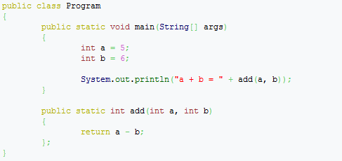
Software Under Test

Slide 15
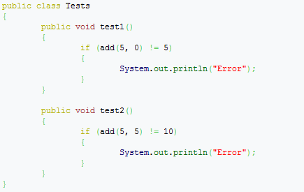
“Advanced” test program

Slide 16
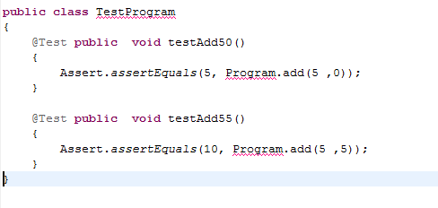
Actual Test

Slide 17
Delivery 3. Static code analysis
Code review
Automated code review
In order to detect
Bugs
Common misuse
Standards mismatch

Slide 18
Review/static analysis checklist
Structure - Does the code conform to coding standards?
Documentation - Are all comments consistent with the code?
Variables - Are all variables properly defined with meaningful, consistent, and clear names?
Arithmetic Operations - Does the code avoid comparing floating-point numbers for equality?
Loops and Branches - Does every case statement have a default?
Defensive Programming-
Are indexes, pointers, and subscripts tested against array, record, or file bounds?
Is every memory allocation deallocated?

Slide 19
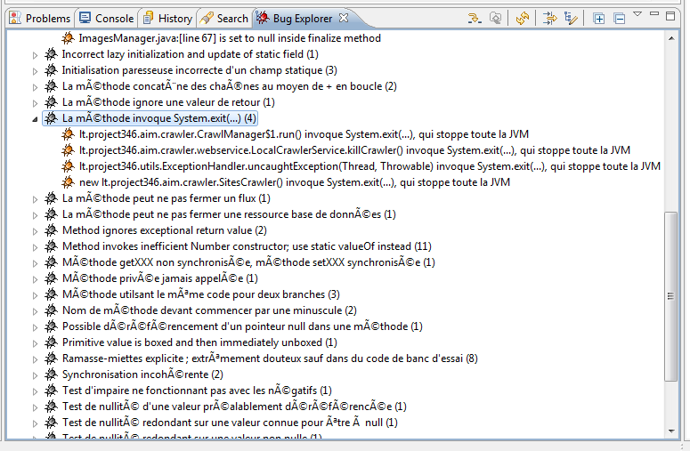
Example – Find Bugs

Slide 20
Delivery 4. Performance testing
Execute application under profiler
Try some use/test cases.
Detect most CPU time using class/method
Simulate high load to server component
Measure average min, max response times

Slide 21
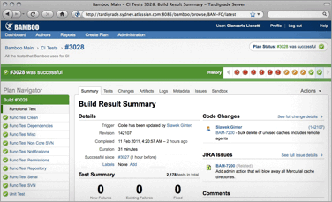
Tools to mention

Slide 22
Nightly build tools
Bamboo
Cruise control
Can run automatically unit tests:
After commit
At regular time intervals

Slide 23
Q/A

